Slide 1
Objective Arts
CANS/ANSA Data Reports
Kate Cordell, PhD, MPH
Policy Fellow
Notes:
The reports described in this presentation and the Objective Arts User Manual have been created by a third party, the Praed Foundation. The report templates are developed and maintained as part of the Objective Arts software package. Any changes or technical support required for report errors should be directed to support of the Objective Arts software.

Slide 2
Project Goals
Goals:
Identify Key Reports Formats: Identify reports which have most value for use at individual level, staff level, and program/agency level.
Customize Parameters of Key Reports: For each key report format, identify the most valuable parameter settings; this may result in multiple versions of the same report set up with different parameters.
Create a Common Language: Identify a Naming Convention so that Key Reports can be easily located, referenced and communicated; e.g., “I ran the Client Progress Initial to Discharge Key Report and found…”
Identify a Process for Key Reports: Identify a process for how/when and why reports will be run; identify how reports will be distributed (push reports or pull reports?).
Create a Common Understanding: Document how to use each Key Report; create user guides with screenshots and example interpretations of mock data; a Key Report User Guide could be used as reference or for training staff; Additional parameter options; how to customize.

Slide 3
Objective Arts Report Types
Through this project five Key Objective Arts Template Reports were identified as most valuable, in order of importance.
Tickler with Episodes Report
TCOM Caseload Progress
Impact Report
TCOM Average Impact

Slide 4
Quality Assurance Reports
Key Report 01 – Reminder Report
Based on the Tickler with Episodes template
Show due and overdue assessments
Uses:
Identify upcoming assessments which are due
Identify when clinicians are late with updating assessments
Pros:
Useful for sending out reminders
Useful for compliance reviews
Key Report 02 - Caseload Progress
Based on the TCOM Caseload Progress template
Show clinician actionable item load by client
Uses:
Shows individual change in number of treatment needs for each client in a caseload for a clinician
Pros:
Can be used by supervisors or clinicians to review caseloads

Slide 5
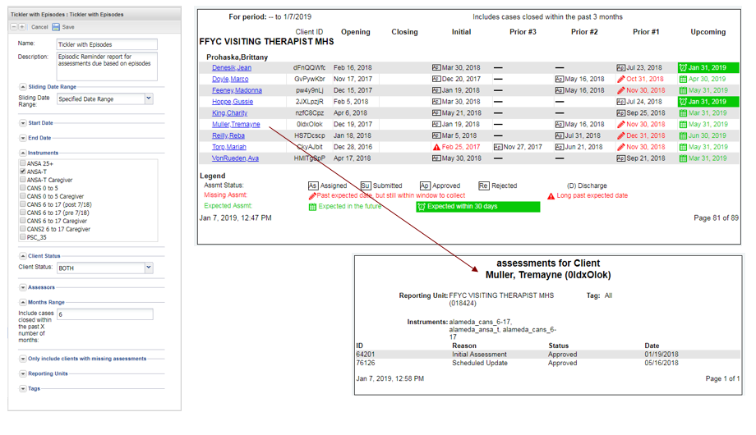
Key Report 01 – Reminder Report
Notes:
The Tickler with Episodes Report – which we refer to as the Key Report 01 – Reminder Report – shows progress of pre-specified questions over time.
It can be useful for sending out reminders of upcoming assessments due and identifying when clinicians are late with assessments for compliance reviews.
Note: Administrators should establish as set of report templates with sets of desired parameters. Staff can either run each report template to review results immediately or have a pdf of the results sent to their email inbox.
Refer to the OA Reports User Manual Alameda County (01/22/2019) at Chapter 2, “Key Report 01 – Reminder Report” page 6 for step-by-step instructions.

Slide 6
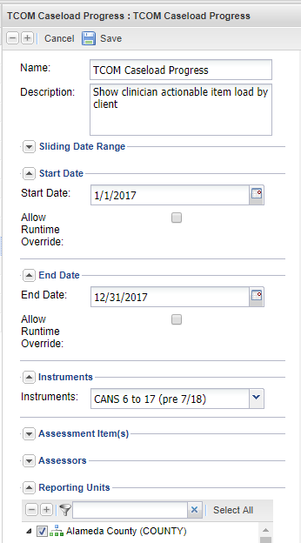
Key Report 02 - Caseload Progress
Notes:
Note: Administrators should establish as set of report templates with sets of desired parameters. Staff can either run each report template to review results immediately or have a pdf of the results sent to their email inbox.
The Caseload Progress – displays the progress of an Assessor’s clients throughout updates of each client’s assessments. It can be useful for tracking when assessments have been completed and for tracking the progress of a client under all or individual domains in that assessment.
Refer to the OA Reports User Manual Alameda County (01/22/2019) at Chapter 3, “Key Report 02 – Caseload Progress” page 36 for step-by-step instructions.

Slide 7
Outcomes Reports
Key Report 03 – Item Impact Report
Based on the Impact template
Lists Time1/Time2 change percentages
Uses:
Identifies proportions who were actionable at initial
Identifies of those actionable, percentage resolved, if discharged
Pros:
Could potentially identify items where programs are impacting issues and where programs are not making good progress on items
Key Report 04 – Domain Impact Report
Based on the TCOM Average Impact Template
Shows Actionable Item progress by domain
Uses:
Compares time 1 average number of actionable treatment needs to time 2 average number of actionable treatment needs by domain
Pros:
Provides an indicator for comparison across groups

Slide 8
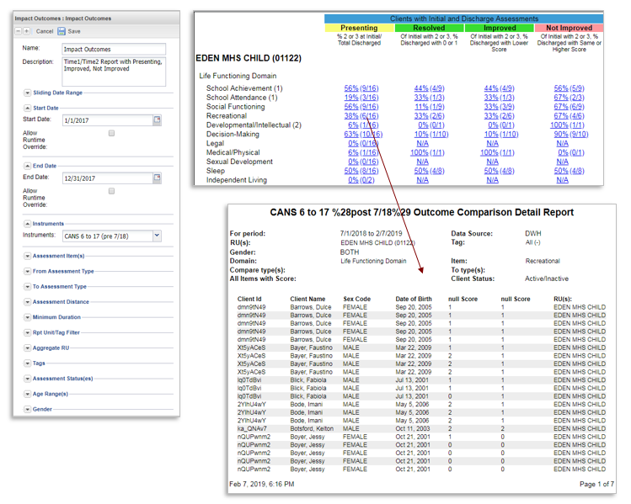
Key Report 03 – Item Impact
Notes:
The Impact Report – which we refer to as the Key Report 03-Item Impact Report – shows the percentage of the domain scores at the initial assessment, initial and discharge assessments, and groups the clients based on their score in the assessment.
Note: Administrators should establish as set of report templates with sets of desired parameters. Staff can either run each report template to review results immediately or have a pdf of the results sent to their email inbox.
Refer to the OA Reports User Manual Alameda County (01/22/2019) at Chapter 4, “Key Report 03 – Item Impact Report” page 21 for step-by-step instructions.

Slide 9
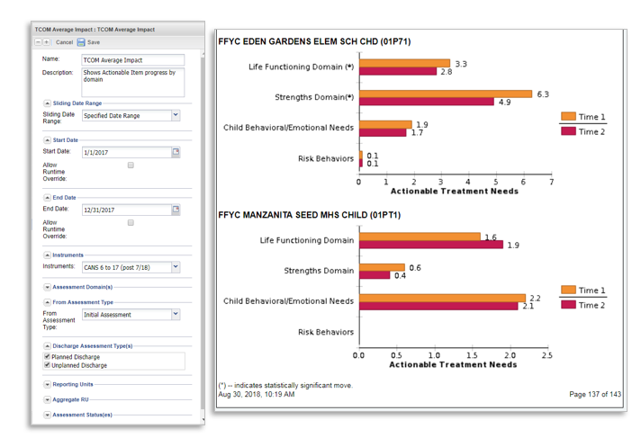
Key Report 04 - Domain Impact
Notes:
The Domain Impact report – which we refer to as TCOM Average Impact Report. This report shows actionable item progress by domain. User can compare time 1 average number of actionable treatment needs to time 2 average number of actionable treatment needs by domain to identify overall improvements in actionable items by domain.
Note: Administrators should establish as set of report templates with sets of desired parameters. Staff can either run each report template to review results immediately or have a pdf of the results sent to their email inbox.
Refer to the OA Reports User Manual Alameda County (01/22/2019) at Chapter 5, “KR04 Domain Impact Report” page 36 for step-by-step instructions.

Slide 10
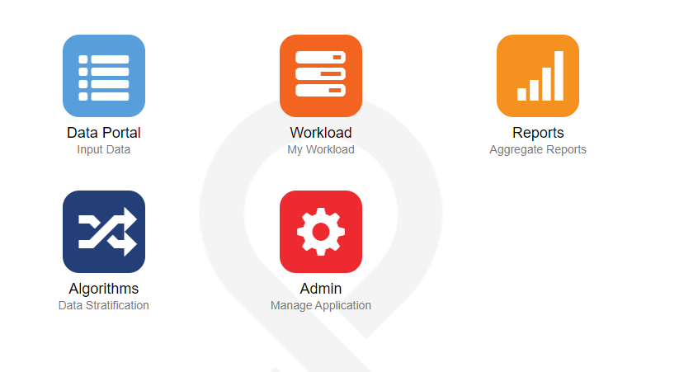
Setting Up Templates
Once logged into your account to create/view new reports click on the ‘Reports’ icon
Notes:
Note: Administrators should establish as set of report templates with sets of desired parameters. Staff can either run each report template to review results immediately or have a pdf of the results sent to their email inbox.

Slide 11
Objective Arts Report Types
OA Report Types
Personal
Shared
Master

Slide 12
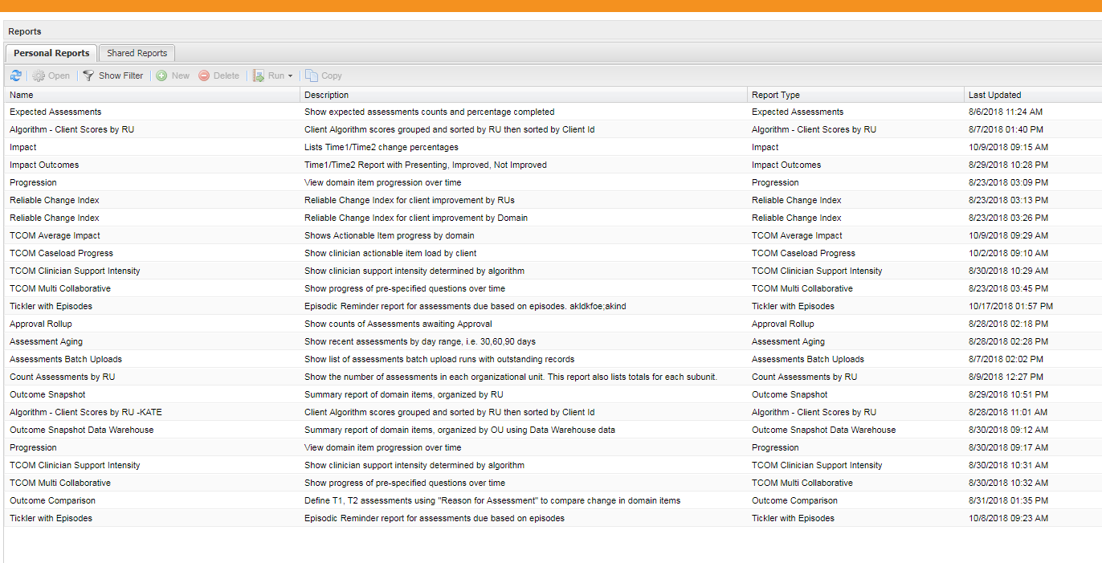
Setting Up Templates
All of your personal saved reports will be displayed on this page along with a brief description of the report, the report type, and the date the report was last modified
Notes:
Note: Administrators should establish as set of report templates with sets of desired parameters. Staff can either run each report template to review results immediately or have a pdf of the results sent to their email inbox.

Slide 13
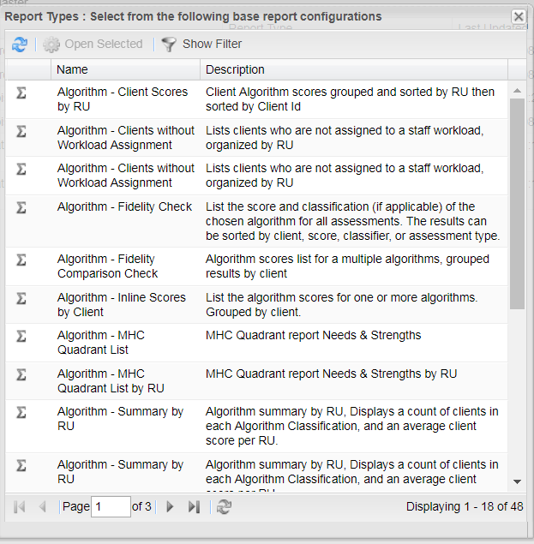
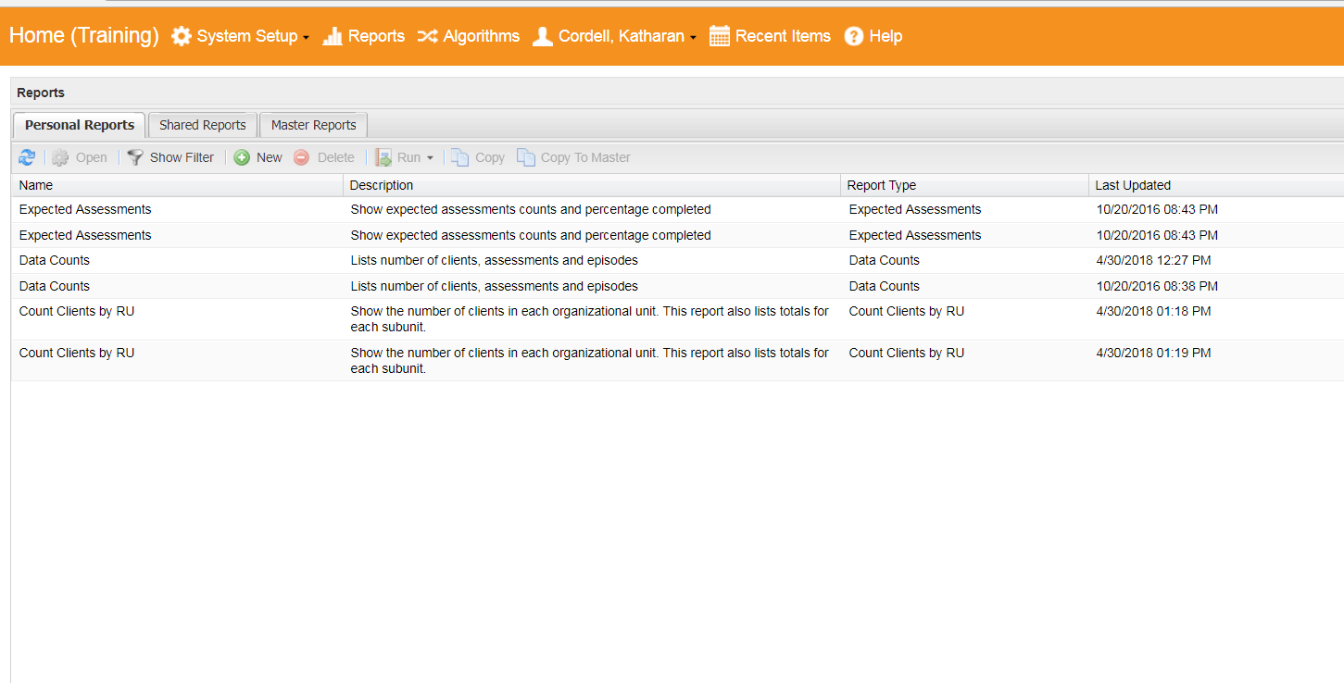
Creating a Template
In the reports view click on +New icon at the top of the list
Select the Report Type from the pop-up
Notes:
Note: Administrators should establish as set of report templates with sets of desired parameters. Staff can either run each report template to review results immediately or have a pdf of the results sent to their email inbox.

Slide 14
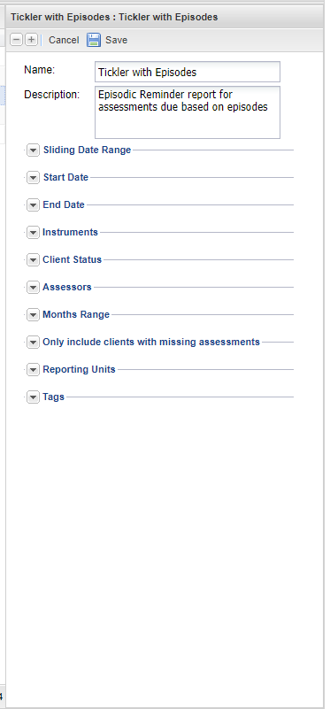
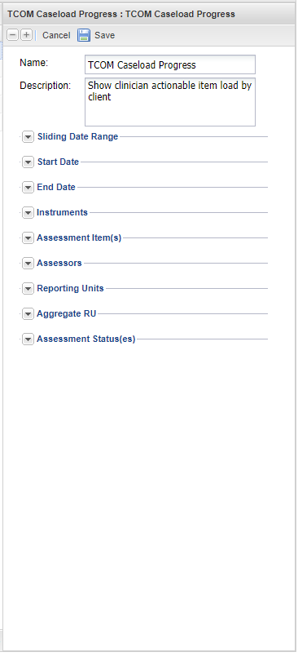
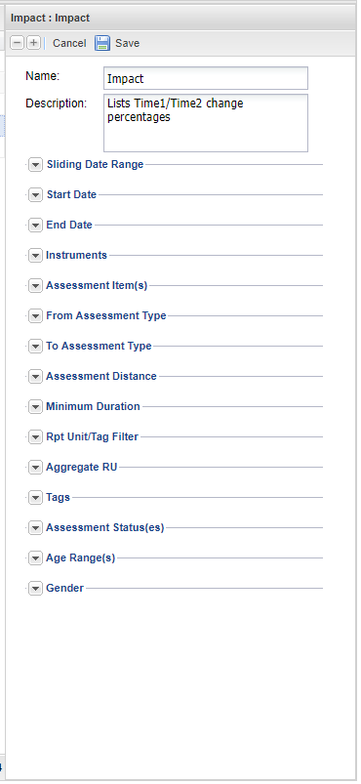
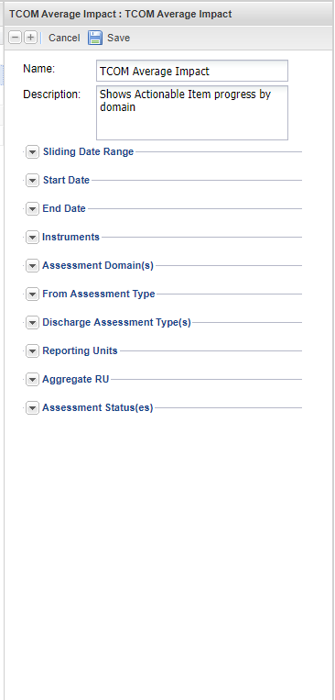
Creating a Template
Adjust the selected report’s parameters.
Notes:
Note: Administrators should establish as set of report templates with sets of desired parameters. Staff can either run each report template to review results immediately or have a pdf of the results sent to their email inbox.

Slide 15
Sharing Templates
From the Personal Reports tab, select the report template to share
Select the ‘Copy to Master’ button.
Select OK once prompted.
Notes:
Note: Administrators should establish as set of report templates with sets of desired parameters. Staff can either run each report template to review results immediately or have a pdf of the results sent to their email inbox.

Slide 16
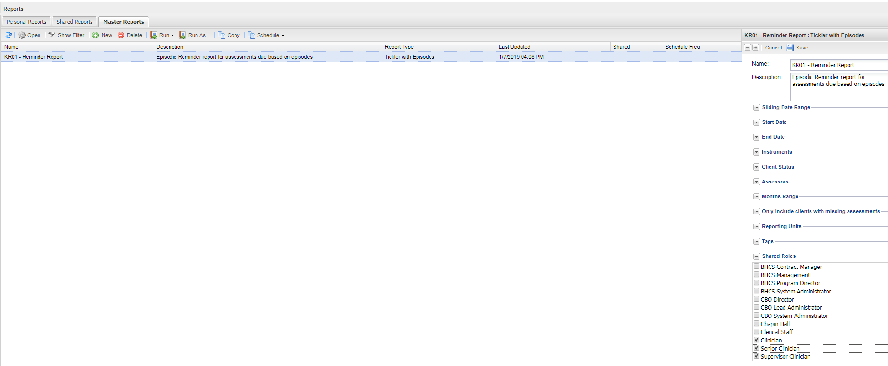
Sharing Templates
Move to the Master Reports tab. You may need to refresh the window in order to see the report.
Double click on the template and now a ‘Shared Roles’ option appears in the report properties window.
Expand the ‘Shared Roles’ and select the appropriate user types who will be able to use the report.
Save the report template properties. It should now appear in the Shared Reports tab for the appropriate user types.
Notes:
Note: Administrators should establish as set of report templates with sets of desired parameters. Staff can either run each report template to review results immediately or have a pdf of the results sent to their email inbox.

Slide 17
Reports for Process Quality Assurance

Slide 18
This Section Covers
Key Report 01 – Reminder Report
Based on the Tickler with Episodes template
Key Report 02 - Caseload Progress
Based on the TCOM Caseload Progress template

Slide 19
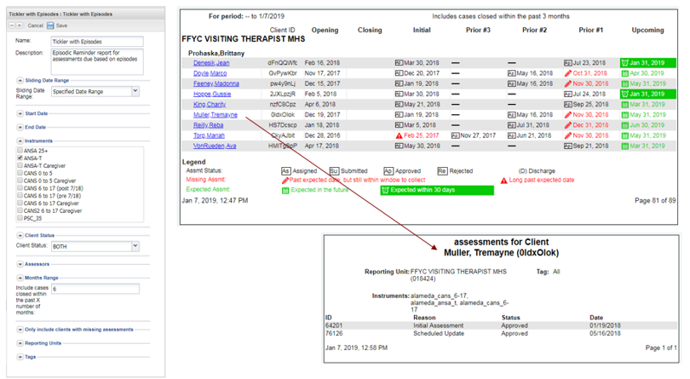
Key Report 01 – Reminder Report (Tickler with Episodes)
Show progress of pre-specified questions over time
Uses:
Identify upcoming assessments which are due
Identify when clinicians are late with updating assessments
Pros:
Useful for sending out reminders
Useful for compliance reviews
Notes:
I noticed when I started updating this PowerPoint on Nov. 27, the screen grab shows a photo with Prior #3 Prior #2 Prior #1, when I went back to update the screen grab to get something that was more filled out for the top photo, the headings now say Update A Update B Update D. Not sure what is going on here? Is this a result of choosing a different assessment? Has the site been updated since the last time I was using it?
Refer to the OA Reports User Manual Alameda County (01/22/2019) at Chapter 2, “Key Report 01 – Reminder Report” page 6 for step-by-step instructions.

Slide 20
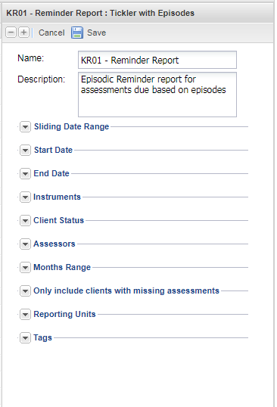
Establishing a Template
Once logged into your account, navigate to the Reports section to create a new report template selecting the “Tickler with Episodes” template; or double click on the template already established in your Personal Reports tab to modify your existing template.
Create a user-friendly name and description specific to the report parameters set in the template. For example, you may want to name the report “KR01 Reminders - Lodi TBS Program for CANS” and give it a description which states: “This report provides reminders of upcoming and recently past due CANS for the Lodi TBS program.”
Naming Convention: We suggest that you begin names of all templates for these reports as ‘KR01 Reminders –’, representing that all templates belong to the same group of assessment reminder reports identified as ‘Key Report 01’.

Slide 21
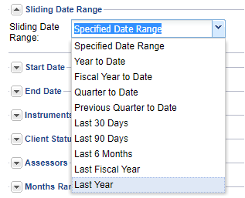
Establishing a Template
The Sliding Date Range is designed to allow users to select from various date ranges for the report
However, the date range for this report restricts the results to only those client placements which opened and closed within the date range specified. Therefore, do not include a date range and leave this field with its default values.
Note: Specifying a date range will create reports with few or no matching client placements. In order to view the report, leave this portion of the parameters empty.

Slide 22
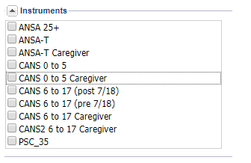
Establishing a Template
Instruments
The ‘Instruments’ allow users to select the appropriate assessment type used for the report. The user can select one or more instruments, but at least one instrument must be selected.
Client Status
This is designed to allow the user to select active and/or inactive clients that would be included in the report. However, this report must be set to either ACTIVE_ONLY or BOTH. These options will return the same results, which will include active clients as well as recently closed clients within the ‘Month Range’ setting.

Slide 23
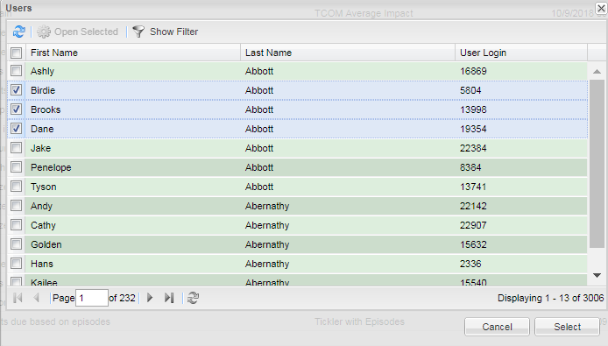
Establishing a Template
Assessors
This allows the user to limit the report to just certain assessors who completed the assessment.
Month Range
The Month Range allows the user to look at assessment completeness for client placements which were recently closed. Setting the month range to 6 months, for example will return inactive cases which were closed in the last 6 months up to today’s date in addition to open cases. If this field is left blank, the report will include all cases closed within the past 3 months from the End Date, by default.

Slide 24
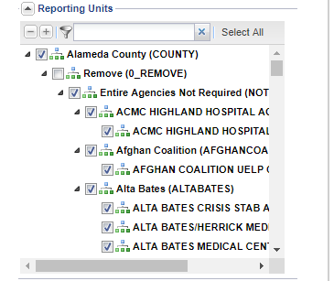
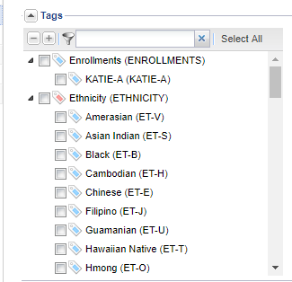
Establishing a Template
Only Include Clients with Missing Assessments
Clicking the check box will create reports that only display clients who have missing assessments. Clients with all assessments completed of those due will be excluded from the report.
Reporting Units
Select the appropriate reporting unit for the report.
Tags
This parameter allows users to identify any client demographics (e.g. ethnicity, language, etc.) on which to filter into the report.
Click the ‘Save’ button at the top of the parameters box to save the changes made.
Note: This will cause the parameters region to appear to go blank, but the changes will be saved.

Slide 25
Running the Report
Select the Tickler with Episodes report from the Reports list
Click on the ‘Run’ icon at the top of the reports list to perform one of the following functions
Click on the ‘Immediate’ button to have the report pop up on your internet browser’s next tab.
Alternatively, click on the ‘Delivered’ to have the report sent to your email account.
Notes:
Refer to the OA Reports User Manual Alameda County (01/22/2019) at Chapter 2, “Key Report 01 – Reminder Report” page 6 for step-by-step instructions.

Slide 26
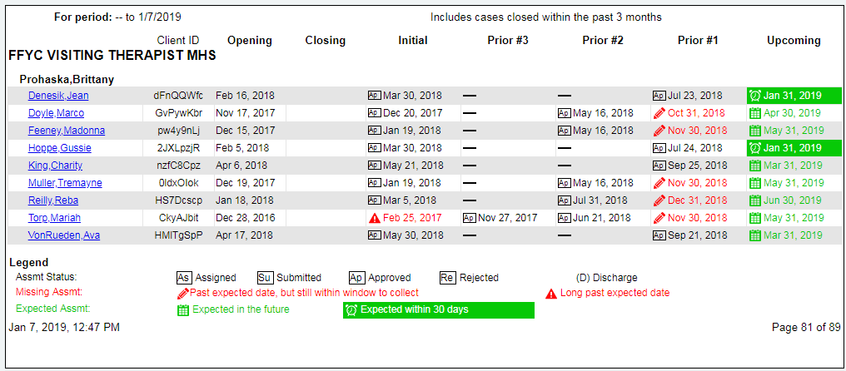
Interpreting the Report
The first pages of the report will display all of the Reporting Units which are represented by the data in the report.
After that initial list of Reporting Units, the report will display pages which organize clients by Assessor, with the Assessor’s name at the top of the first column
Each client will have an Opening Date and a Closing Date (if applicable). The Closing Date represents the date the episode was closed, if it is closed.
Notes:
Refer to the OA Reports User Manual Alameda County (01/22/2019) at Chapter 2, “Key Report 01 – Reminder Report” page 6 for step-by-step instructions.

Slide 27
Interpreting the Report
Assessments are displayed horizontally and include the initial (in the “Initial” column) and three most recent prior assessments (in the “Prior #1”, “Prior #2” and “Prior #3” columns).
Assessments which were completed show in black text.
Notes:
If more than four assessments exist, then those which are before the three most prior and after the initial will not display. In addition, the next upcoming assessment due date is displayed in the farthest right column with the header “Upcoming”.
Refer to the OA Reports User Manual Alameda County (01/22/2019) at Chapter 2, “Key Report 01 – Reminder Report” page 6 for step-by-step instructions.

Slide 28
Interpreting the Report
Completed assessment also display a status box
If the assessment satisfies the requirements for the collection window for a discharge, then a (D) will also appear following the assessment date.
Notes:
If more than four assessments exist, then those which are before the three most prior and after the initial will not display. In addition, the next upcoming assessment due date is displayed in the farthest right column with the header “Upcoming”.
Refer to the OA Reports User Manual Alameda County (01/22/2019) at Chapter 2, “Key Report 01 – Reminder Report” page 6 for step-by-step instructions.

Slide 29
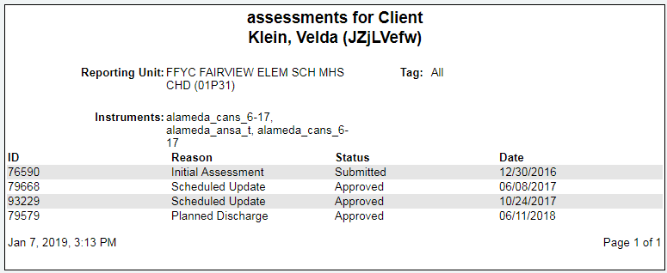
Interpreting the Report
Assessments which are past due show in red text.
An assessment becomes past due on the day after it was due.

Slide 30
Closing represents the date the episode was closed, if the episode has closed
There were no further prior assessments due nor completed for this client
The Upcoming assessment due dates are shown for all active clients. Assessments due in the next 30 days are highlighted in green
Assessor
Clients
The discharged client has no upcoming assessment due
The most recent Prior assessment is past due but still within the allowable window for timely collection
This Prior assessment is long past due and is no longer within the allowable window for timely collection
Initial assessment was submitted [Su] has not yet been approved [Ap]
Notes:
If more than four assessments exist, then those which are before the three most prior and after the initial will not display. In addition, the next upcoming assessment due date is displayed in the farthest right column with the header “Upcoming”.
If a pencil shows next to the past due assessment, this means that the window to collect the assessment is still open, and a user can still submit an assessment to comply with an allowable timely assessment window. In this case, once the assessment is submitted, the red text will turn to black and show the actual date the assessment was collected.
Alternatively, if a triangle exclamation icon is displaying next to the red text, this means that the assessment is long past due and that the allowable assessment collection window has closed. In this case, the user can still submit an assessment, but the submitted assessment will not clear out the past due assessment. The newly submitted assessment will show in black but will not satisfy the prior assessment due, which will continue to display in red with a triangle exclamation icon.
Refer to the OA Reports User Manual Alameda County (01/22/2019) at Chapter 2, “Key Report 01 – Reminder Report” page 6 for step-by-step instructions.

Slide 31
Interpreting the Report
Clicking on a specific client name will launch a sub report displaying all of the Assessments for the case, including Reason, Status and Date.

Slide 32
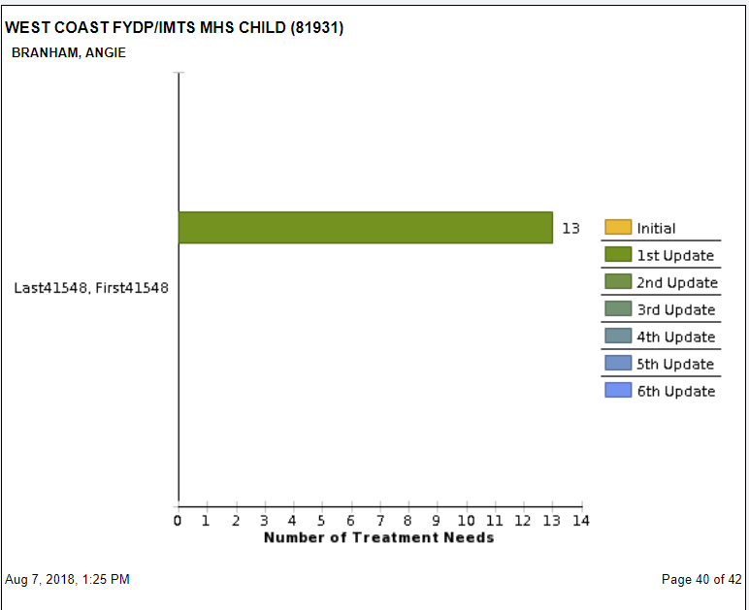
Key Report 02 – Caseload Progress (TCOM Caseload Progress)
Show clinician actionable item load by client
Uses:
Shows individual change in number of treatment needs for each client in a caseload for a clinician
Pros:
Can be used by supervisors or clinicians to review caseloads
Cons:
Graphical display can be overwhelming for large caseloads, and no data table accompanies graph
How do they set parameters for when an update is due
Notes:
Note: Administrators should establish a set of report templates with sets of desired parameters. For example, the administrator may want to create a report template for each reporting unit and/or for each assessment type. The report template names can be changed to reflect the specific parameter settings for that report (e.g., “KR02 Caseload Progress – TBS Children” and “KR02 Caseload Progress – FSP TAY”). Once the templates are established and shared with staff, staff can quickly run each report template to review results immediately or have a pdf of the results sent to their email inbox.

Slide 33
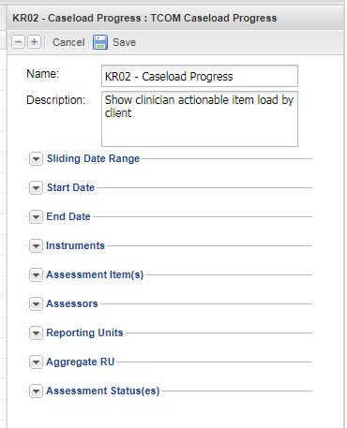
Establishing a Template
Once logged into your account, navigate to the Reports section to create a new report template selecting the “TCOM Caseload Progress” template; or double click on the template already established in your Personal Reports tab to modify your existing template.
Create a user-friendly name and description specific to the report parameters set in the template. For example, you may want to name the report “KR02 Caseload Progress – Strengths in Lodi TBS Program” and give it a description which states: “This report provides caseload progress for each client’s actionable strength items over time for the Lodi TBS program.”
Naming Convention: We suggest that you begin names of all templates for these reports as ‘KR02 Caseload Progress –’. For example, ‘KR02 Caseload Progress – Strengths’ represents that a template belonging to the same group of reports identified as ‘Key Report 02’ demonstrating caseload progress, specifically in the strengths domain items.

Slide 34
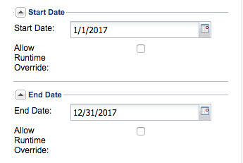
Establishing a Template
The Sliding Date Range is designed to allow users to select from various date ranges for the report
These prespecified date ranges will include all open cases along with any cases which were closed during the period specified.
Note: The report will always return all open cases regardless of date selection. Selecting the sliding or specified date range only adjusts which closed cases are included in the report.
Alternatively, selecting ‘Specified Date Range’ in the Sliding Date Range parameter will allow you to adjust the ‘Start Date’ and ‘End Date’ in which to include closed cases

Slide 35
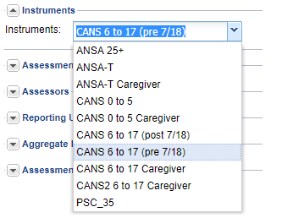
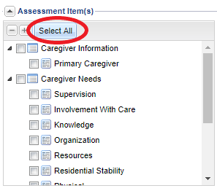
Establishing a Template
Instruments
‘Instruments’ allow users to select the appropriate assessment type used for the report. The user can select one.
Assessment Item(s)
Select the domains and items to be included in the report. The report will count up all selected items which were scored as a 2 or 3 on an assessment as a total number of Treatment Needs for that assessment. For example, if you select only the Caregiver Needs domain and all its items, the report will display the specific number of Treatment Needs (scored as 2 or 3) for caregivers.
Alternatively, click ‘Select All’ if you would like to produce a report with all the domains.

Slide 36
Establishing a Template
Assessors
This allows the user to limit the report to just certain assessors who completed the assessment.
Reporting Units
Select the appropriate reporting unit for the report.
Aggregate RU
Click the check box in this section to merge all clients in the same caseload across Reporting Units for an Assessor. This will only affect the report if an Assessor has clients across multiple Reporting Units. If the box is not checked, the Assessor’s clients will be displayed in separate sections respective to their Reporting unit, as that Assessor will be displayed in each Reporting Unit for which the Assessor has clients.

Slide 37
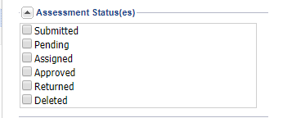
Establishing a Template
Assessment Status(es)
This parameter allows users to select one or more stages of assessments’ status for the report. For example, the user may want to restrict the report to count treatment needs from only ‘Approved’ assessments.
Click the ‘Save’ button at the top of the parameters box to save the changes made.
Note: This will cause the parameters region to appear to go blank, but the changes will be saved.

Slide 38
Running the Report
Select the record from the Reports tab
Click on the ‘Run’ icon at the top of the reports list to perform one of the following functions
Click on the ‘Immediate’ button to have the report pop up on your internet browser’s next tab.
Alternatively, click on the ‘Delivered’ to have the report sent to your email account.
Notes:
Refer to the OA Reports User Manual Alameda County (01/22/2019) at Chapter 3, “Key Report 02 – Caseload Progress” page 36 for step-by-step instructions.

Slide 39
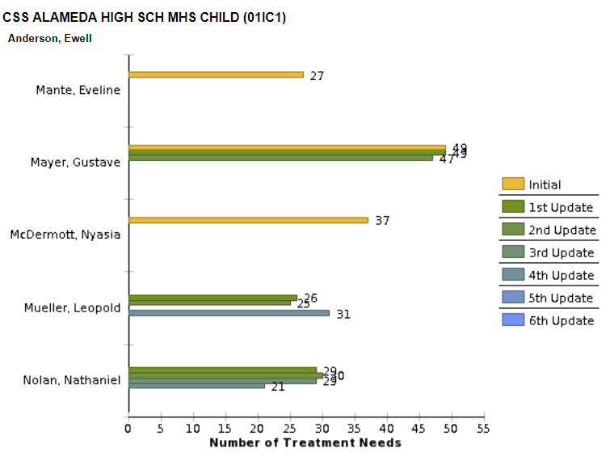
Interpreting the Report
The first pages of the report will display all of the Reporting Units which are represented by the data in the report.
After that initial list of Reporting Units, the report will display pages which organize clients by Assessor, with the Assessor’s name at the top of the first column
Notes:
Refer to the OA Reports User Manual Alameda County (01/22/2019) at Chapter 3, “Key Report 02 – Caseload Progress” page 36 for step-by-step instructions.

Slide 40
Reporting Unit
Assessor
This client had 49 treatment needs on the Initial assessment and the 1st Update but had 47 treatment needs on the 2nd Update
Clients
Last, First Name
Last, First Name
Assessments
Last, First Name
Last, First Name
Last, First Name
Notes:
Note: It is important to note that if a client has 49 treatment needs at initial and 49 treatment needs at 1st update, as is displayed in the example in Figure 3.2.2, that this does not mean that nothing has changed. Many of the treatment needs from the initial could have been resolved, but just as many new treatment needs were discovered. For example, 10 treatment needs might have been addressed and 10 new treatment needs discovered. It is common early in an episode to discover new items as staff build trusting relationships with clients and as clients continue to share or develop their stories.
Refer to the OA Reports User Manual Alameda County (01/22/2019) at Chapter 3, “Key Report 02 – Caseload Progress” page 36 for step-by-step instructions.

Slide 41
Reports for Client Outcomes

Slide 42
This Section Covers
Key Report 03 – Item Impact Report
Based on the Impact Template
Lists Time1/Time2 change percentages
programs are impacting issues and where programs are not making good progress on items
Key Report 04 – Domain Impact Report
Based on the TCOM Average Impact Template
Shows Actionable Item progress by domain

Slide 43
Key Report 03 – Item Impact (Impact Outcomes)
Lists Time1/Time2 change percentages
Uses:
Identifies proportions who were actionable at initial
Identifies of those actionable, percentage resolved, if discharged
Pros:
Could potentially identify items where programs are impacting issues and where programs are not making good progress on items
Notes:
Refer to the OA Reports User Manual Alameda County (01/22/2019) at Chapter 4, “Key Report 03 – Item Impact Report” page 21 for step-by-step instructions.

Slide 44
Establishing a Template
Once logged into your account, navigate to the Reports section to create a new report template selecting the “Impact Outcomes” template; or double click on the template already established in your Personal Reports tab to modify your existing template.
Create a user-friendly name and description specific to the report parameters set in the template. For example, you may want to name the report “KR03 Item Impact on Risk Behaviors – Lodi TBS Program” and give it a description which states: “This report provides the proportion of children/youth presenting with risk behaviors (scored as 2 or 3) as well as the proportion of youth who resolved, improved or worsened in scores for risk behaviors for the Lodi TBS program.”
Naming Convention: We suggest that you begin names of all templates for these reports as ‘KR03 Item Impact on XXX –’, representing that all templates belong to the same group of reports identified as ‘Key Report 03’ demonstrating impact on some set of domain items (replace XXX with the specific domain items or with ‘All Items’).

Slide 45
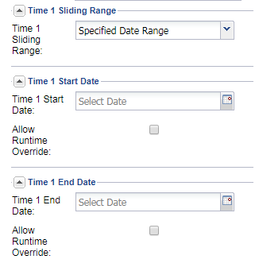
Establishing a Template
The Time 1 Sliding Date Range allows users to select from various date ranges to restrict the “From Assessment Type” for the report.
The Time 1 Sliding Date Range binds Time 1 of the From Assessment Type selected for the report. For example, if the user selects ‘Initial’ for the From Assessment Type, then the Sliding Date Range will include records which have an Initial Assessment within the sliding date range selection.
Alternatively, selecting nothing in the Time 1 Sliding Range, but then entering dates in the ‘Time 1 Start Date’ and ‘Time 1 Ending Date’ will allow you to limit the Time 1 Assessments to the date range entered.
Alternatively, selecting noting in the Time 1 date fields will allow the Time 1 Assessments to be from any time period.

Slide 46
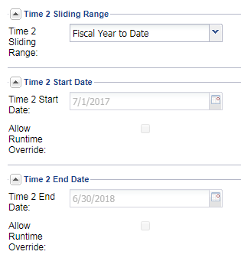
Establishing a Template
The Time 2 Sliding Date Range allows users to select from various date ranges to restrict the “To Assessment Type” for the report.
The Time 2 Sliding Date Range binds Time 2 of the From Assessment Type selected for the report. For example, if the user selects ‘Planned Discharge’ for the To Assessment Type, then the Sliding Date Range will include records which have a Planned Discharge Assessment within the sliding date range selection.
Alternatively, selecting nothing in the Time 2 Sliding Range, but then entering dates in the ‘Time 2 Start Date’ and ‘Time 2 Ending Date’ will allow you to limit the Time 2 Assessments to the date range entered.
Alternatively, selecting noting in the Time 2 date fields will allow the Time 2 Assessments to be from any time period.

Slide 47
Establishing a Template
Instruments
The ‘Instruments’ allow users to select the appropriate assessment type used for the report. The user can select one or more instruments, but at least one instrument must be selected.
Client Status
This is designed to allow the user to select active and/or inactive clients that would be included in the report. However, this report must be set to either ACTIVE_ONLY or BOTH. These options will return the same results, which will include active clients as well as recently closed clients within the ‘Month Range’ setting.

Slide 48
Establishing a Template
The Time 1 Sliding Date Range allows users to select from various date ranges to restrict the “From Assessment Type” for the report.
The Time 1 Sliding Date Range binds Time 1 of the From Assessment Type selected for the report. For example, if the user selects ‘Initial’ for the From Assessment Type, then the Sliding Date Range will include records which have an Initial Assessment within the sliding date range selection.
Alternatively, selecting nothing in the Time 1 Sliding Range, but then entering dates in the ‘Time 1 Start Date’ and ‘Time 1 Ending Date’ will allow you to limit the Time 1 Assessments to the date range entered.
Alternatively, selecting noting in the Time 1 date fields will allow the Time 1 Assessments to be from any time period.

Slide 49
Establishing a Template
The Time 2 Sliding Date Range allows users to select from various date ranges to restrict the “To Assessment Type” for the report.
The Time 2 Sliding Date Range binds Time 2 of the From Assessment Type selected for the report. For example, if the user selects ‘Planned Discharge’ for the To Assessment Type, then the Sliding Date Range will include records which have a Planned Discharge Assessment within the sliding date range selection.
Alternatively, selecting nothing in the Time 2 Sliding Range, but then entering dates in the ‘Time 2 Start Date’ and ‘Time 2 Ending Date’ will allow you to limit the Time 2 Assessments to the date range entered.
Alternatively, selecting noting in the Time 2 date fields will allow the Time 2 Assessments to be from any time period.

Slide 50
Establishing a Template
Instruments
‘Instruments’ allow users to select the appropriate assessment type used for the report. The user can select one.
Assessment Item(s)
Select the domains and items to be included in the report. The report will count up all selected items which were scored as a 2 or 3 on an assessment as a total number of Treatment Needs for that assessment. For example, if you select only the Caregiver Needs domain and all its items, the report will display the specific number of Treatment Needs (scored as 2 or 3) for caregivers.
Alternatively, click ‘Select All’ if you would like to produce a report with all the domains.

Slide 51
Establishing a Template
From Assessment Type
This parameter sets the primary boundary for the Assessment Time 1 from when the initial assessment was taken. Different options will appear depending on the Instrument selected.
To Assessment Type
This parameter identifies the types of Assessments for Time 2. If multiple options are selected, it will take the last assessment of the qualifying assessment for each client.
Note: After running the report, the ‘To Assessment Type’ parameter will be displayed as ‘Discharge’ in the results, but it may include only Scheduled Updates if it is the only option selected.

Slide 52
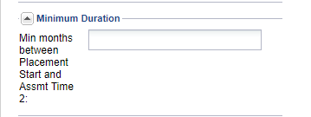
Establishing a Template
Assessment Distance
This allows users to input a minimum number of months in between the Assessment Time 1 Date and the Assessment Time 2 Date for the clients
Minimum Duration
This allows users to input a minimum number of months in between the Episode Start Date and the Assessment Time 2 Date for the clients. The Assessment Start Date is usually before the Assessment Time 1 Date, and therefore allows for a slightly different time restriction criteria as compared to the Assessment Distance criterion.

Slide 53
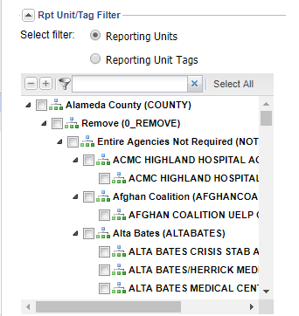
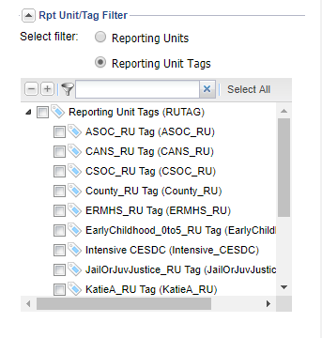
Establishing a Template
RPT Unit/Tag Filter
With the Reporting Units toggle selected, select the appropriate reporting unit for the report
.
Alternatively, switch the toggle to the Reporting Unit Tags option and select a tag which would be associated with a group of reporting units, such as TBS, for example.
Note: A selection must be made from either the Reporting Units or the Reporting Unit Tags options for the report to run. Switching between the toggles clears the selections. Selections can only be made on one of the options.

Slide 54
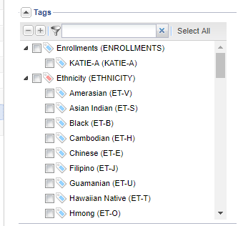
Establishing a Template
Aggregate RU
Click the check box in this section to merge data across all reporting units selected for the report. This will show the results in one final table containing all reporting units combined.
Tags
This parameter allows users to identify any client demographics (e.g. ethnicity, language, etc.) they wish to filter into the report
Assessment Status(es)
This parameter allows users to select one or multiple stages of the assessment’s status for the report. By default, Submitted and Approved assessments are selected for inclusion in the report.

Slide 55
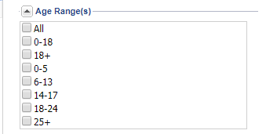
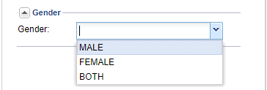
Establishing a Template
Age Range(s)
Users may select a specific age range for their report.
Gender
Optionally, select a gender to limit the report to a Males or Females.
Click the ‘Save’ button at the top of the parameters box to save the changes made.

Slide 56
Running the Report
Select the record from the Reports tab
Click on the “Impact Report” template; or double click on the template already established in you Personal Reports tab to modify you existing template.
Notes:
Note: Administrators should establish a set of report templates with sets of desired parameters. For example, the administrator may want to create a report template for each reporting unit and/or for each assessment type – or for a specific set of domain items, such as for a strengths report. The report template names can be changed to reflect the specific parameter settings for that report (e.g., “KR03 Item Impact – TBS Children” and “KR03 Item Impact – FSP TAY”). Once the templates are established and shared with staff, staff can quickly run each report template to review results immediately or have a pdf of the results sent to their email inbox.
Refer to the OA Reports User Manual Alameda County (01/22/2019) at Chapter 4, “Key Report 03 – Item Impact Report” page 21 for step-by-step instructions.

Slide 57
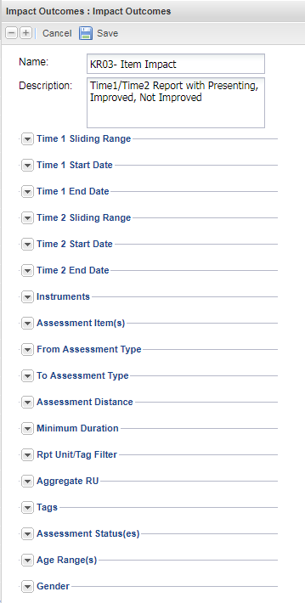
Running the Report
Adjust the report parameters.
Click the Save button at the top of the parameters box to save the changes made.
This will cause the parameters region to appear to go blank, but the changes will be saved.
Select the same record from the Reports tab again
Click on the Run icon at the top of the reports list
Click on the ‘Immediate’ button to have the report pop up on your internet browser’s next tab.
Alternatively, click on the ‘Delivered’ to have the report sent to your email account.
Notes:
Note: Administrators should establish a set of report templates with sets of desired parameters. For example, the administrator may want to create a report template for each reporting unit and/or for each assessment type – or for a specific set of domain items, such as for a strengths report. The report template names can be changed to reflect the specific parameter settings for that report (e.g., “KR03 Item Impact – TBS Children” and “KR03 Item Impact – FSP TAY”). Once the templates are established and shared with staff, staff can quickly run each report template to review results immediately or have a pdf of the results sent to their email inbox.
Refer to the OA Reports User Manual Alameda County (01/22/2019) at Chapter 4, “Key Report 03 – Item Impact Report” page 21 for step-by-step instructions.

Slide 58
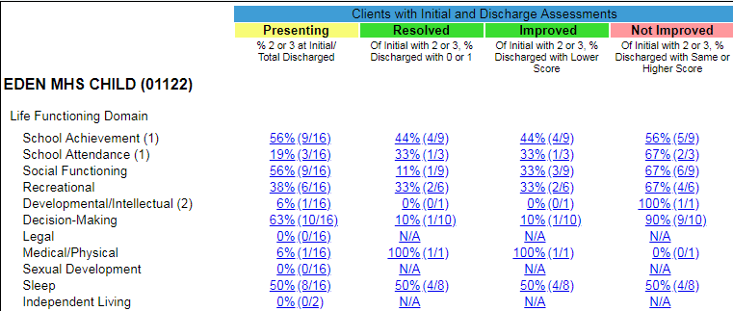
Presenting column shows the proportion of clients who had a 2 or 3 of those who scored the item.
Resolved column shows the proportion of client who had an actionable presenting item which was resolved to a score of 0 or 1 by Time 2, which is often discharge, but could be latest schedule update if selected as the To Assessment.
Improved column represents the proportion of clients who had an actionable presenting item which improved in any way at Time 2. This includes all those in the Resolved column plus any items which presented as a score of 3 and improved to a score of 2.
Not Improved column represents the proportion of clients who had an actionable presenting item which stayed the same or increased from 2 to 3 by Time 2.
The number of clients counted in each row may fluctuate as clients are excluded if they did not answer or answered “N/A” on items.
Clicking on any value will generate another report in a new tab which will show all assessments for these clients.
Social Functioning Not Improved – for the nine clients who presented with a score of 2 or 3, six (66%) had the same or an increased score at Time 2.
Items included in the report are listed and organized by domain. This report includes Life Functioning Domain Items
Social Functioning Presenting – for the Social Functioning Item, nine (56%) clients scored a 2 or 3 out of 16 clients scored for this item.
Social Functioning Resolved – for the nine clients who presented with a score of 2 or 3, one (11%) had a score of 0 or 1 at Time 2
Social Functioning Improved – for the nine clients who presented with a score of 2 or 3, three (33%) had an improvement in score at Time 2.

Slide 59
The first pages of the report will display all of the Reporting Units which are represented by the data in the report. After that initial list of Reporting Units and the report will display the resulting tables for each reporting unit or for all reporting units combined if the Aggregate RU option was selected
Clicking on any of the hyperlink values in the table of the report will open a sub report of the clients represented by the denominator of the hyperlinked value.

Slide 60
Key Report 04 – Domain Impact (TCOM Average Impact)
This report shows actionable item progress by domain. User can compare time 1 average number of actionable treatment needs to time 2 average number of actionable treatment needs by domain to identify overall improvements in actionable items by domain.
Notes:
The TCOM Average Impact report. This report shows actionable item progress by domain. User can compare time 1 average number of actionable treatment needs to time 2 average number of actionable treatment needs by domain to identify overall improvements in actionable items by domain.

Slide 61
Establishing a Template
Once logged into your account, navigate to the Reports section to create a new report template selecting the “TCOM Average Impact” template; or double click on the template already established in your Personal Reports tab to modify your existing template.
Create a user-friendly name and description specific to the report parameters set in the template. For example, you may want to name the report “KR04 Domain Impact on Core+Suicide at Planned Discharge – Lodi TBS” and give it a description which states: “This report provides the average number of treatment needs per child for each of the core domains plus the Suicide Risk module – comparing initial to planned discharge.”
Naming Convention: We suggest that you begin names of all templates for these reports as ‘KR04 Domain Impact on XXX –’, representing that all templates belong to the same group of reports identified as ‘Key Report 04’ demonstrating impact on some set of domains (replace XXX with the specific domains).

Slide 62
Establishing a Template
The Sliding Date Range is designed to allow users to select from various date ranges for the report
Alternatively, selecting ‘Specified Date Range’ in the Sliding Date Range parameter will allow you to adjust the ‘Start Date’ and ‘End Date’
The report will return all clients who were discharged in the timeframe

Slide 63
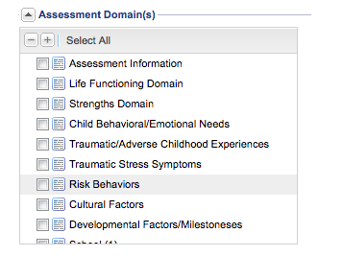
Establishing a Template
Instruments
‘Instruments’ allow users to select the appropriate assessment type used for the report. The user can select one.
Assessment Domain(s)
These are the domains of the assessment selected to produce the report on. The domains displayed will vary in each report depending on the assessment you selected in the previous parameters.
Click ‘Select All’ if you would like to produce a report with all the domains (not recommended).
To create a report with a specific domain(s) you may click the check box next to the domain(s) desired (recommended).
Note: It is recommended that the user limit the report to 5-6 domains or fewer. More domains will cause the report to be difficult to read as the chart labels will overlap. A separate template can be created for sets of 5-6 domains.

Slide 64
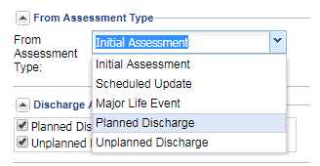
Establishing a Template
From Assessment Type
This parameter sets the primary boundary for the Assessment Time 1 from which the report will extract information from. Different options will appear depending on the Instrument selected. Select the ‘Initial Assessment’ for this option.
Note: When available, failing to select a parameter in this option will prevent the report to be saved or run. Also, if there are several scheduled updates or major life events per youth, then each youth may contribute more than one data point, sometimes and often unequally. It is recommended that these options are not selected. Also, it would not make sense to select a discharge option to compare to a discharge option. It is recommended that the user only select the Initial Assessment here.

Slide 65
Establishing a Template
Discharge Assessment Type(s)
This parameter sets the secondary boundary for the Assessment Time 2 from which the report will extract information from.
Note: After running the report, the ‘To Assessment Type’ parameter will be displayed as ‘Discharge Reasons’ in the results.

Slide 66
Establishing a Template
Reporting Units
Select the appropriate reporting unit for the report.
Aggregate RU
Click the check box in this section to merge data across all reporting units selected for the report. This will show the results in one final table containing all reporting units combined.
Assessment Status(es)
This parameter allows users to select one or multiple stages of assessments’ status for the report. For example, the user may want to restrict the report to count treatment needs from only ‘Approved’ assessments.
Click the ‘Save’ button at the top of the parameters box to save the changes made.

Slide 67
Running the Report
Select the record from the Reports tab
Click on the “Impact Report” template; or double click on the template already established in you Personal Reports tab to modify you existing template.

Slide 68
Running the Report
Adjust the report parameters.
Click the Save button at the top of the parameters box to save the changes made.
This will cause the parameters region to appear to go blank, but the changes will be saved.
Select the same record from the Reports tab again
Click on the Run icon at the top of the reports list
Click on the ‘Immediate’ button to have the report pop up on your internet browser’s next tab.
Alternatively, click on the ‘Delivered’ to have the report sent to your email account.

Slide 69
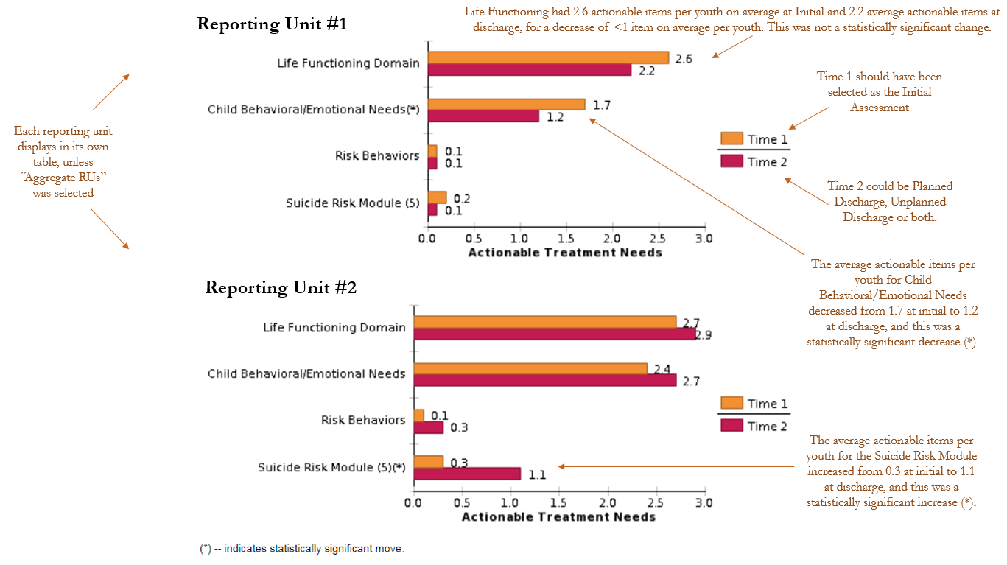
Notes:
It is important to note that if a set of clients had an average of 2.7 treatment needs at initial and 2.9 treatment needs at discharged, as is displayed for Life Functioning Domain under Reporting Unit #2 in the Figure that this does not mean that all youth go worse. Some of the treatment needs from the initial could have been resolved but this report shows that more treatment needs were discovered than were resolved. For example, 10 treatment needs might have been addressed and 15 new treatment needs discovered. It is common early in an episode to discover new items as staff build trusting relationships with clients and as clients continue to share or develop their stories. It is impossible to tell from this report how many treatment needs were resolved versus how many were discovered.

Slide 70
Kate Cordell, PhD, MPH
Policy Fellow

